Slide 1


PY-EXPO
2K24
Team ID: T110
Team Name: Nerd Network
Genius innovation leaves behind a legacy...
PYEXPO 2K24

Slide 2
PS Code : PY21
Problem Statement:
Network Security Prediction System
Our aim is to create a model that can forecast a system's safety level and suggest enhancements to boost security, successfully protecting user data.
02
PYEXPO 2K24

Slide 3
Solution :
Our Network Security Prediction System anticipates and proactively mitigates cyber threats, enhancing overall cybersecurity. It identifies potential vulnerabilities, predicts emerging risks, and fortifies networks in real-time. This innovative solution empowers users to:
Alert Suspicious Activities
Enhance Incident Response
Uncovering Network Vulnerabilities
Reduce Phishing activities
03
PYEXPO 2K24

Slide 4
04
Role of Protocol Analysis in Cyber Security
Threat detection and classification
Preventing phishing attacks
Email monitoring
8Steps involved in Processing the Network Traffic:
Packet Capture
Filtering
Protocol Decoding
Session Reconstruction
Traffic Analysis:
Protocol Inspection
PYEXPO 2K24

Slide 5
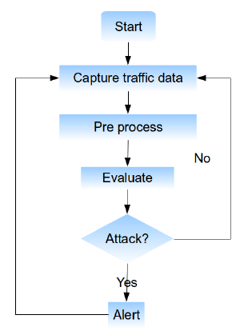
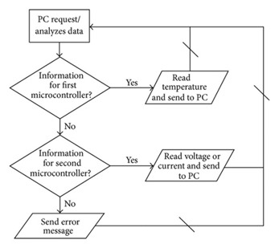
Technology Stack:
Programming Language : Python
Development Tools : VS Code
Libraries : Pyshark
05
PYEXPO 2K24

Slide 6
Team Member Details:
Sreesanth S
Sivakumara Sowmiya P
Vimitha S
Mowax M
06
PYEXPO 2K24

